Slide 1

EXCEL MODULE 3 – FORMULA REFERENCING RECAP
Enhancing Your Data Analysis Skills Pathway
2023

Slide 2
Agenda
Relative Referencing
Absolute Referencing
Naming cells
Naming ranges
Exercise

Slide 3
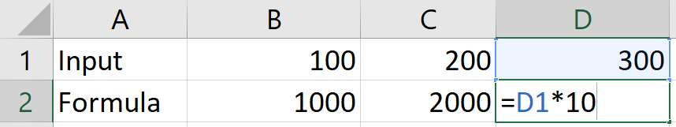
Relative Referencing
Each cell in Excel has a name in the ‘ColumnRow’ format.
Cell B10 is the cell in Column B / Row 10.
By default the reference style in a cell is a relative reference.
That means if you copy that cell to another cell, the references will move accordingly.

Slide 4
absolute Referencing
With absolute referencing, you can fix the reference to a specific column, row or both using the ‘$’ sign.
Assign absolute cell references in three ways:
$A$1 → $Column$Row = both the column (A) and row (1) are fixed.
$A1 → $ColumnRow = only the column (A) is fixed.
A$1 → Column$Row = only the row (1) is fixed.
When in a cell, use F4 as the shortcut to quickly toggle between the different reference styles.

Slide 5
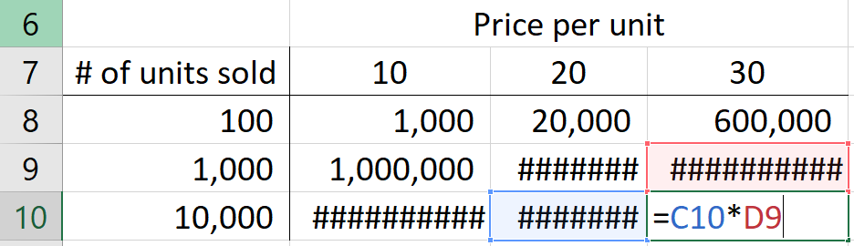
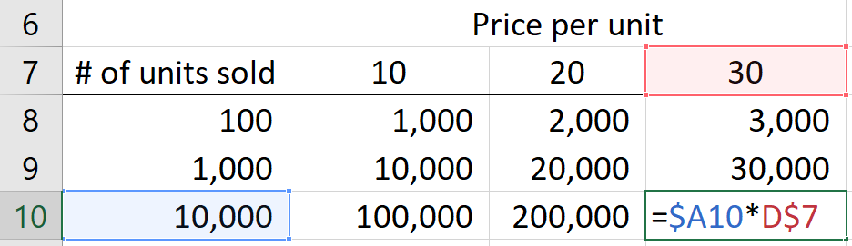
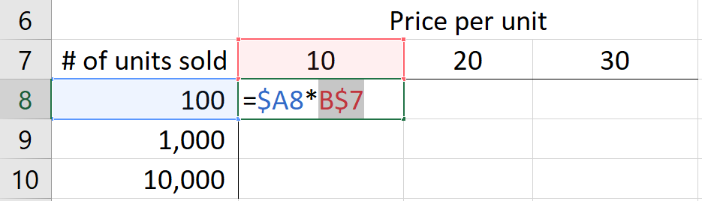
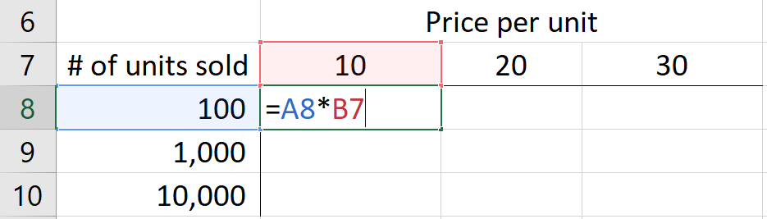
absolute Referencing Example
Fix column A and row 7
Correct referencing is used when formula is copied across the table.
Incorrect referencing is used.

Slide 6
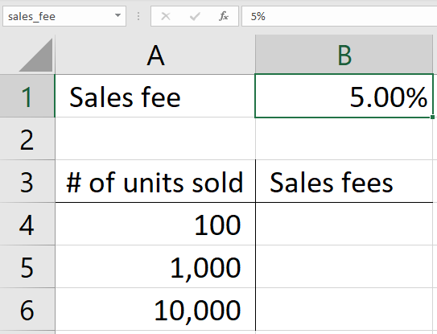
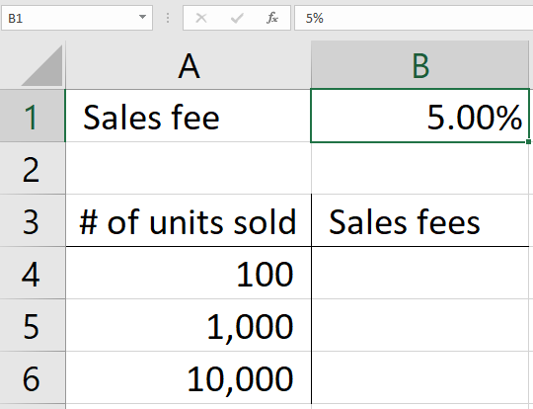
Naming cells
Type a name for the call into the Name box and press Enter to apply.

Slide 7
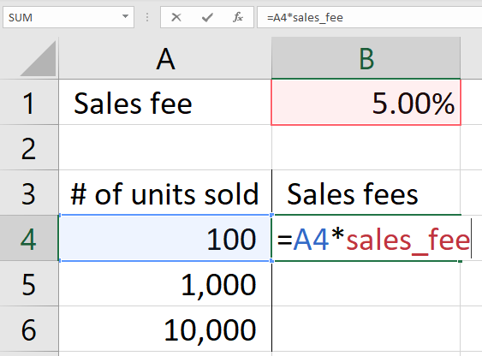
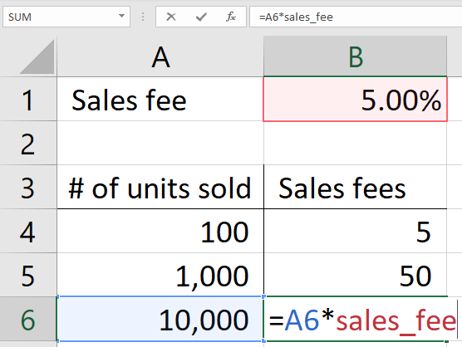
Naming cells
A named cell will automatically be an absolute reference.

Slide 8
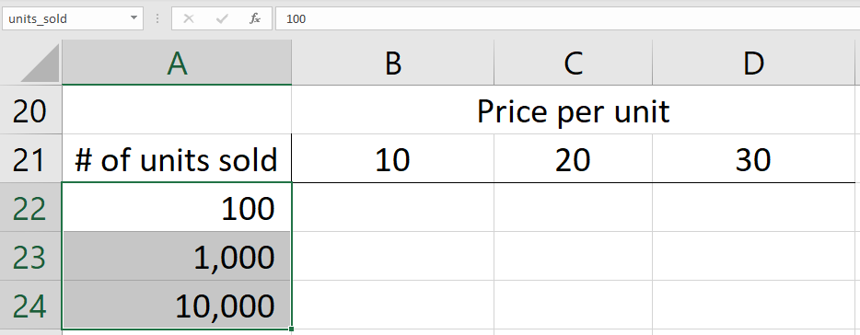
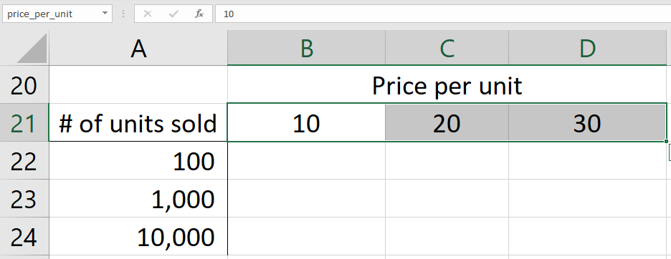
Naming ranges
B21:D21 = price_per_unit
A22:A24 = units_sold

Slide 9
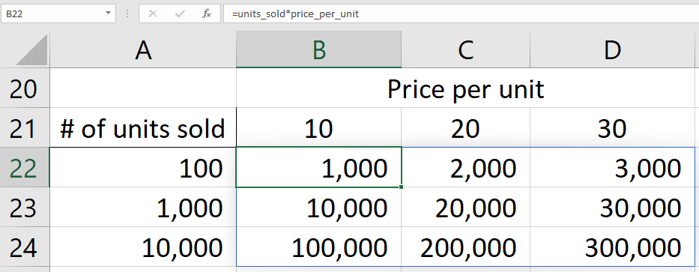
Naming ranges

Slide 10
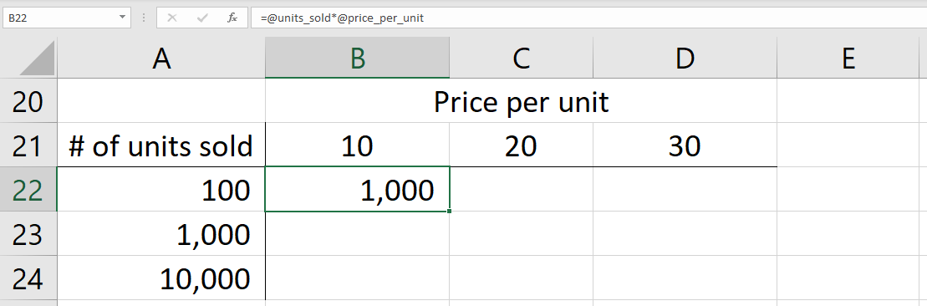
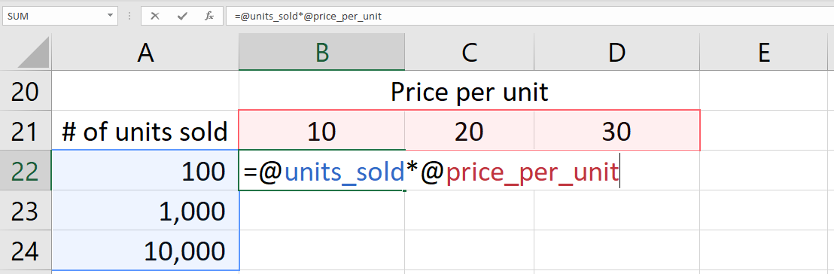
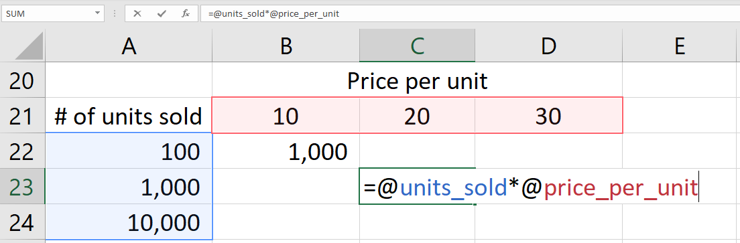
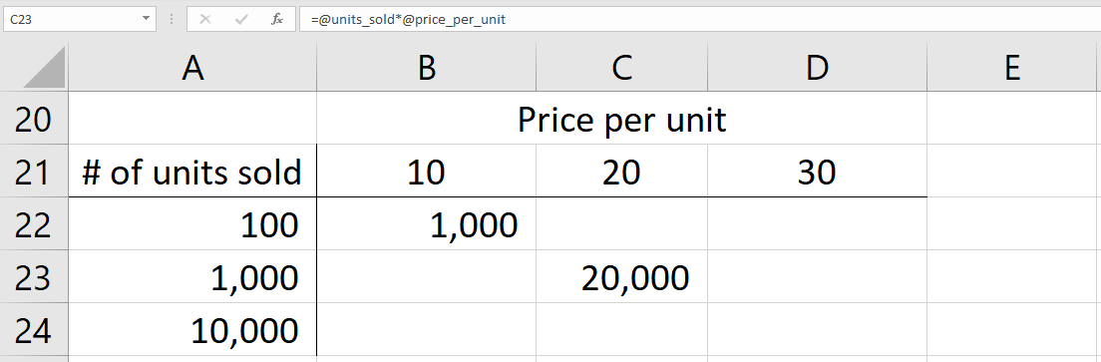
Naming ranges
Use the @ symbol in front of the reference to only calculate the value in one particular cell.

Slide 11
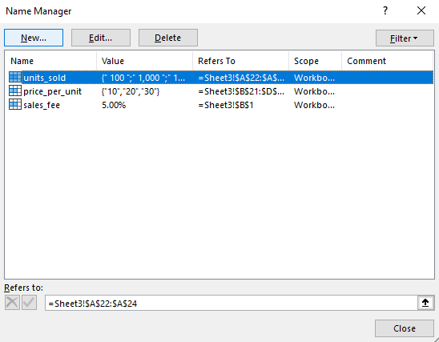
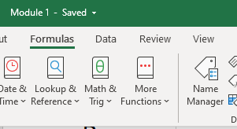
Name manager
Any changes to cell and range references need to be made in the Name Manager
You can not override the name by typing the Name box.
Access the Name Manger via Formulas / Name Manager
Or simply use CTRL + F3 as a shortcut!

